Slide 1
Phoswich PET Module Geometry and Readout Channels
Bill Worstell
CapeSym
1/1/2022

Slide 2
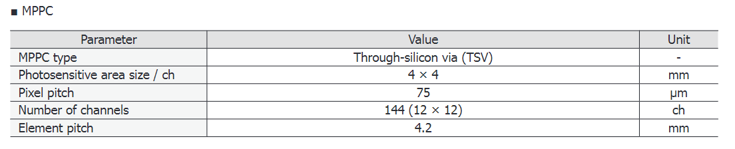
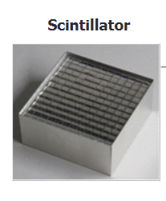
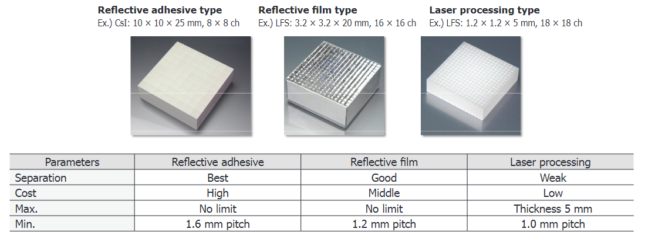
MPPC Module for PET Hamamatsu Technical Note
www.hamamatsu.com/resources/pdf/ssd/pet_module_kacc9009e.pdf

Slide 3
MPPC Module for PET Hamamatsu Technical Note
3.2 x 3.2 x L mm CZC, 16 x 16 array
3.2 x 3.2 x T mm BGO, 16 x 16 array
Reflective film or adhesive type
www.hamamatsu.com/resources/pdf/ssd/pet_module_kacc9009e.pdf

Slide 4

Chicheportiche, A., Marciano, R. and Orevi, M., 2020. Comparison of NEMA characterizations for Discovery MI and Discovery MI-DR TOF PET/CT systems at different sites and with other commercial PET/CT systems. EJNMMI physics, 7(1), pp.1-20.
ASIC Channel Density Estimate
Xtal | 3.95 | mm | Tx
 | 5.3 | mm | Ax
 | 25 | mm | Thickness
Block | 9 |  | NBTx
 | 4 |  | NBAx
 | 35.55 | mm | BTx
 | 21.2 | mm | Bax
Detectpr | 2 |  | NDTx
 | 2 |  | NDAx
 | 71.1 | mm | DTx
 | 42.4 | mm | Dax
Ring | 34 |  | NTx
 | 5 | cm | RAx
 | 241.74 | cm | R Circum
 | 76.9 |  | R Diameter
 | 4.0 |  | NRing
 | 19584 |  | NXtals
 | 612 |  | Xtals/RingTx
 | 32 |  | XtalsAx
 | 19584 |  | CheckXtals
Each detector block contains a 4 × 9 array of small lutetium-based scintillators (LBS), with crystals placed on three 3 × 2 arrays of silicon photomultiplier (SiPM) detectors, for a total of 19,584 crystals and 9792 SiPM channels.
GE: 60 mm^2/SiPM channel
Proposed phoswich detector block has a 5 x 5 array of SiPMs, each 1cm x 1cm
Phoswich/SiPMs |  | Channels/Block | mm^2/Ch
Single Ended, Single Time Window | Non-Imaging SiPMs | 32 | 78.1
 | Imaging SiPMs | 128 | 19.5
Single Ended, Double Time Window | Non-Imaging SiPMs | 64 | 39.1
 | Imaging SiPMs | 256 | 9.8

Slide 5

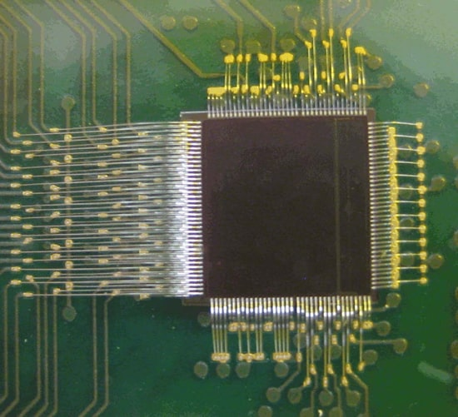
PETsys TOFPET2 ASIC
The PETsys High Performance TOFPET2 ASIC is a new 64 channel chip for the readout and digitization of signals from fast photon detectors in applications where a high data rate and fast timing is required. It uses a low threshold for timing and a high threshold for accepting the event. Both thresholds are separately configurable for each channel. Every time one of the 64 channels exceeds the high threshold a record is created giving the channel number, the time and the charge of the event. Activity in one channel does not cause any dead-time on the other channels
https://www.petsyselectronics.com/web/public/products/1

Slide 6
5cm x 5cm detector module
w/ 5 x 5 array of 10mm x 10mm SiPMs

Slide 7
CZC

Slide 8
BGO

Slide 9
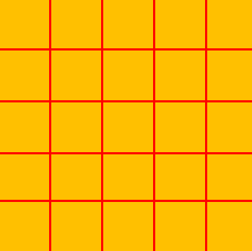
CZC
BGO
Light Mixer and SiPM Array

